Slide 1

INTER-UNIVERSITY GENAI HACKATHON FOR SDGS 2026
Resilience
Travel Assistant
TEAM 1076 / TOMORROW
Green Transport & Smart Mobility
A travel decision-support tool that helps Hong Kong and cross-border commuters choose departure times, compare disruption risks, and prepare alternatives using transport data, transparent rules, and constrained explanations.
CLEARER CHOICES
UNDER DISRUPTION
TEAM MEMBERS
Ji Jie · Lingnan University
Xiaowen LI · City University of Hong Kong
xu tianyi · The University of Hong Kong
Liu jiaming · Lingnan University
Jiang Yunhan · The University of Hong Kong
Notes:
We are Tomorrow, Team 1076. This deck shows a working two-stage prototype. The optional server-side GenAI adapter explains structured decisions; transport data and validation limits are clearly marked.

Slide 2

Brand Identity & Visual Design
/ LOGO DESIGN
Multiple Routes, Clear Decisions
Interconnected routes represent alternative travel options.
/ VISUAL IDENTITY
Calm, Clear & Reliable
Deep teal and dark blue create a calm, trustworthy visual identity.
/ PRODUCT PHILOSOPHY
Fixed Commute. Transparent Rules.
Data-driven insights help commuters compare risks and plan alternatives.
Resilience Travel Assistant
Know your route. Know when to go.
Inter-University GenAI Hackathon for SDGs 2026
02
Notes:
15 seconds. We are Tomorrow, Team 1076. Our prototype helps commuters decide when to leave, which route to use and when to switch or defer. This deck separates working software from simulated data and planned AI deployment.

Slide 3
A disruption changes the whole journey
11.7 million
158.1 mm
public transport journeys per day
in Hong Kong, 2024
rainfall in one hour at HKO
7 September 2023, 23:00–24:00
A traveller still has to decide whether the entire trip is feasible, how much time to allow, and when an alternative stops being useful.
Sources: Hong Kong Transport Department (2025 digest), Hong Kong Observatory (September 2023)
03
Notes:
25 seconds. Hong Kong recorded around 11.7 million public transport journeys per day in 2024. The September 2023 rainstorm caused widespread traffic disruption. Our focus is the decision a commuter must make before leaving, especially when transfers and deadlines interact. These statistics establish context, not product demand. Sources: https://www.td.gov.hk/mini_site/atd/2025/en/section5-1.html
https://www.hko.gov.hk/en/wxinfo/pastwx/mws2023/mws202309.htm

Slide 4
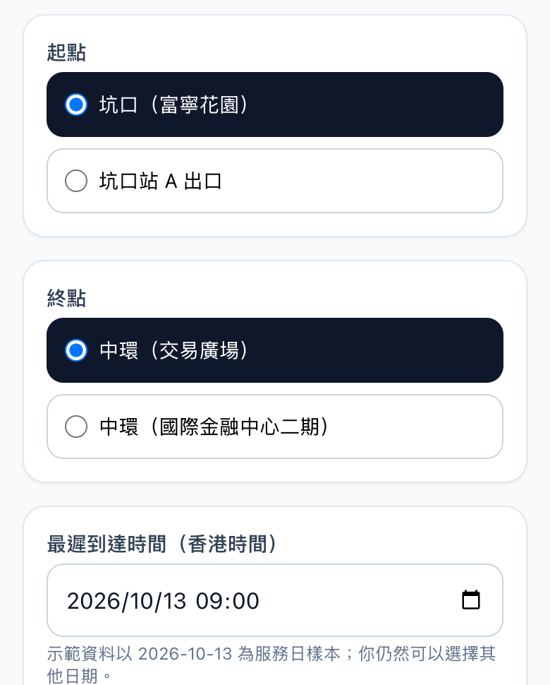
The first users have a deadline
Fixed commute, visible constraints
A traveller enters an origin, destination and latest arrival time, then sets limits for extra cost and transfers.
The same screen can switch between normal, rain and transport-disruption fixtures.
The first target users are students and workers with repeated trips and a hard deadline. Interviews and field trials remain pending.
Project scope and research plan: original project proposal. User interviews and field trials remain pending.
04
Notes:
20 seconds. We focus on students and workers who repeat a trip, use transfers and must arrive on time. Our hypothesis is that combining deadlines, fallback conditions and uncertainty reduces their decision burden. We have not yet established demand through completed interviews or trials. The image is an archived browser QA capture of the actual first-stage input page. Chinese controls correspond to origin, destination, arrival deadline, extra cost, transfers and scenario.

Slide 5

A working route comparison
Recommended: Lok Ma Chau | Alternative: Lo Wu | Alternative: Shenzhen Bay
81 min + queue and buffer | 91 min + queue and buffer | 132 min + queue and buffer
Arrival 09:33–09:59 Low risk / Medium confidence | Arrival 09:49–10:31 Medium risk / Low confidence | Arrival 10:32–11:17 Medium risk / Low confidence
 |  | Conservative ETA misses deadline
Actual local prototype screenshot, 17 October 2026. Fixed demonstration data. English translation below.
05
Notes:
25 seconds. This screenshot comes from the working application, using the Central to Futian demonstration. The selected route, alternatives and lateness warning are visible. The table translates every Chinese label in the captured cards. These are fixtures, not live transport predictions.

Slide 6
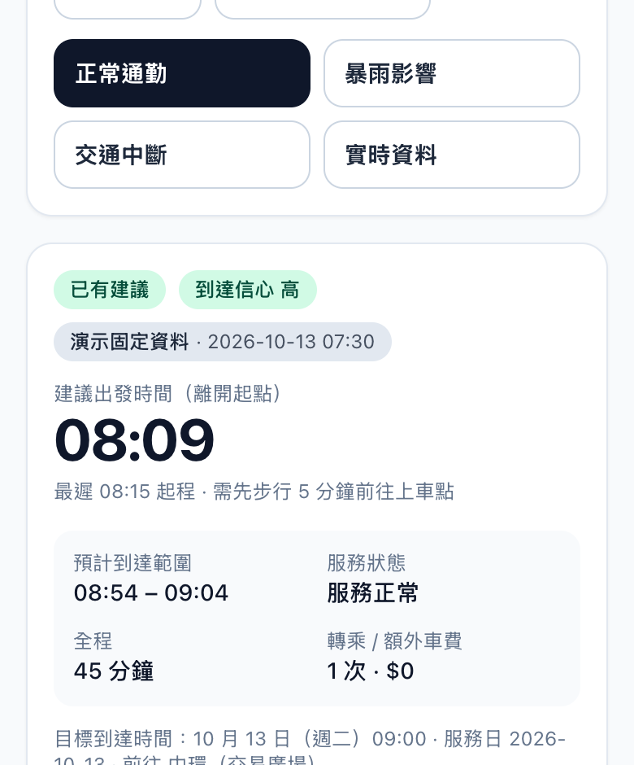
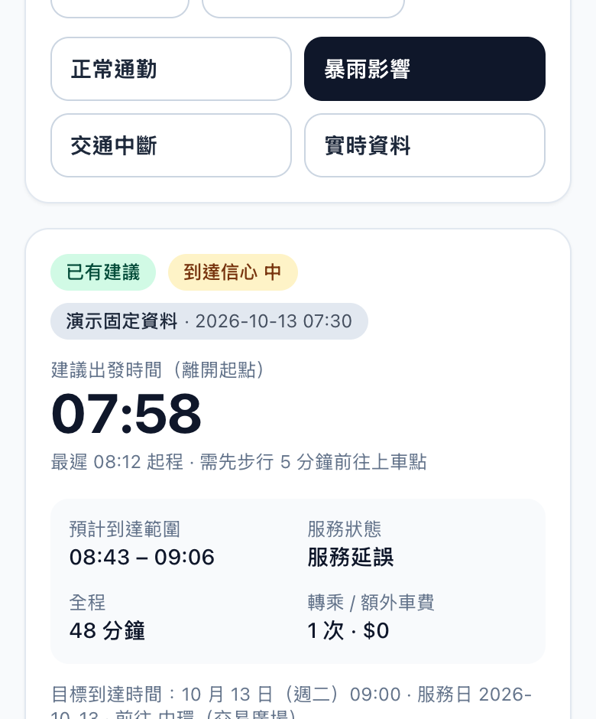
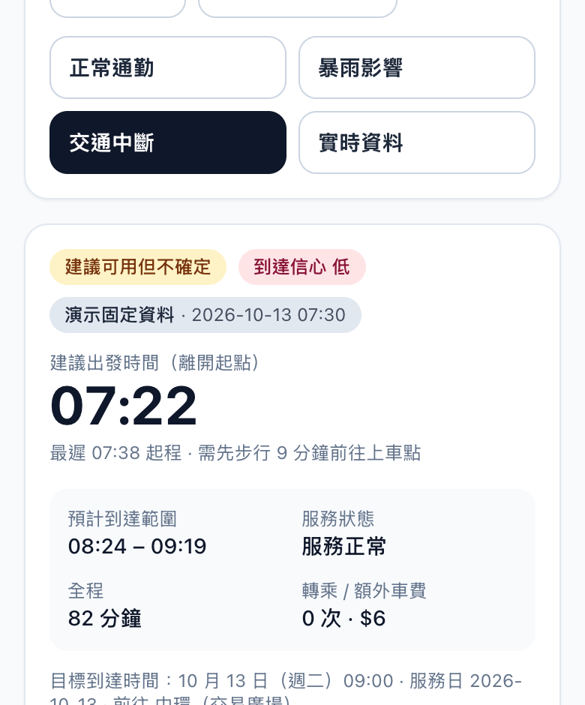
The response changes with the scenario
Normal
Heavy rain
Transport disruption
08:09 · high confidence
07:58 · medium confidence
07:22 · low confidence
Sources: archived browser QA captures (13 Oct 2026) and release recheck (17 Oct 2026).
06
Notes:
30 seconds. These are actual first-stage browser QA captures from the three fixed scenarios. Normal recommends leaving at 08:09 with high confidence. Heavy rain shifts advice to 07:58 with medium confidence. Transport disruption gives 07:22 with low confidence and a changed route. The integrated cross-border demo is separate: normal Lok Ma Chau, disruption Shenzhen Bay and black-rain hold. Source: https://github.com/jijie114514-oss/eight-university-hackathon/blob/a140f0817a5e91bd9319fd0632f940934e975e31/release-checks/RELEASE_REVIEW.md The three images are archived real browser QA captures of the first-stage product, all using fixed demonstration data. They show normal 08:09, heavy rain 07:58 and transport disruption 07:22. The cross-border demo has separate behavior: normal Lok Ma Chau, disruption Shenzhen Bay and black-rain hold.

Slide 7
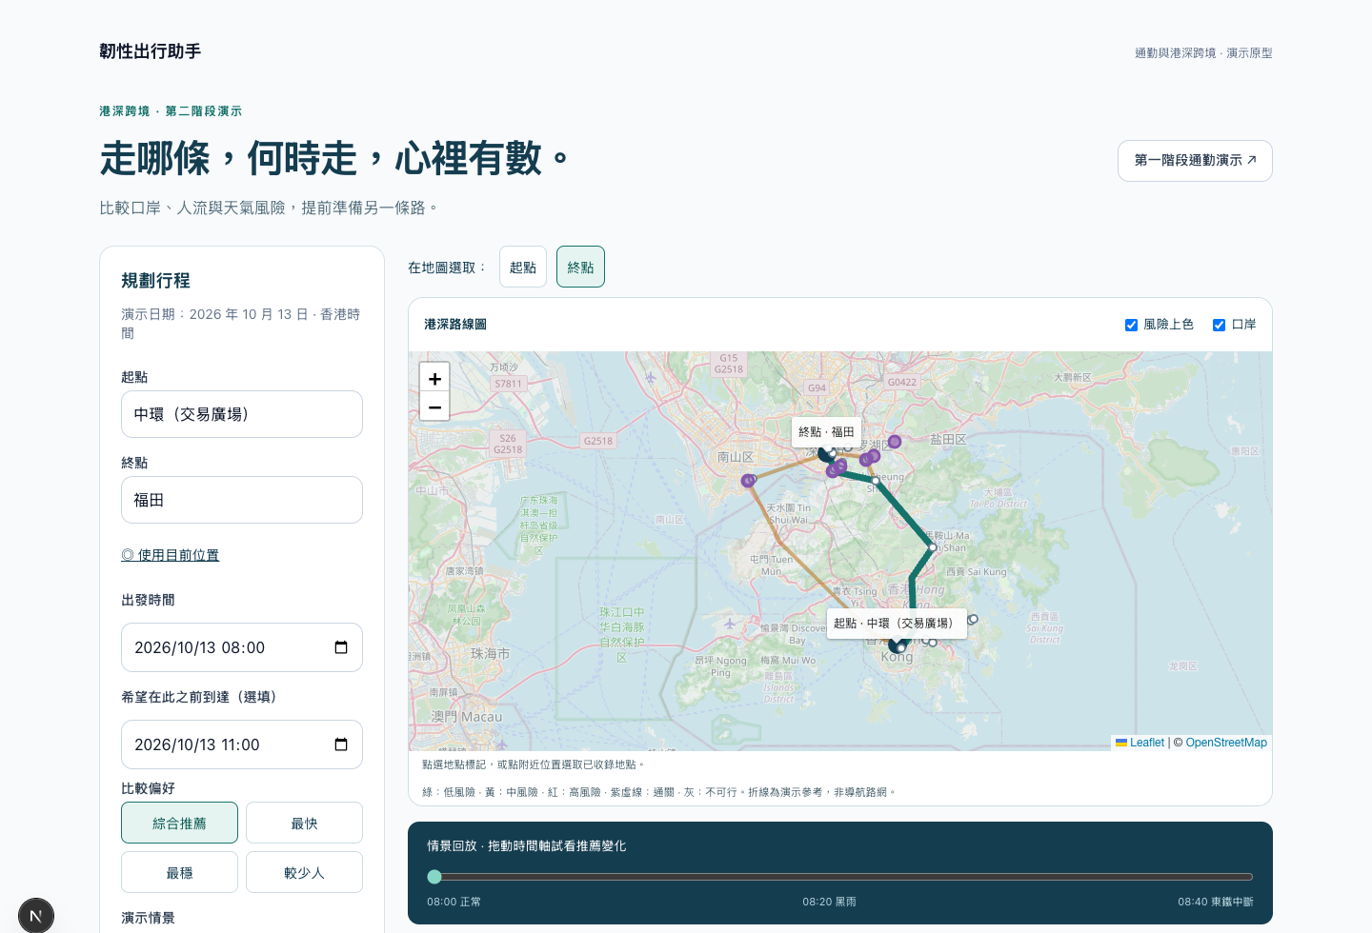
Two routing modes with explicit boundaries
Actual second-stage page
Trip form, map, risk overlay and scenario replay are visible.
9,466 stops and 2,452 usable routes in the HK snapshot.
The public Shenzhen leg requires a private server-side Amap key. Static timetables are not live ETAs.
Source: integrated app README, transit data and recorded provider probes.
07
Notes:
25 seconds. The reproducible demo is separate from public routing. The Hong Kong snapshot contains 9,466 stops and 2,452 routes. Public cross-border routing connects Shenzhen Bay and Heung Yuen Wai with an Amap-backed Shenzhen leg. The release environment has no Amap key. Archived provider probes are available, but do not prove universal coverage. https://github.com/jijie114514-oss/eight-university-hackathon/blob/a140f0817a5e91bd9319fd0632f940934e975e31/A%E9%83%A8%E5%88%86/app/docs/transit/TRANSIT_COVERAGE.md The image is an archived actual browser QA screenshot of the second-stage map page. The first-stage fixed demonstration and public routing mode are separate; the latter supports two road borders and requires a private Amap key for the Shenzhen provider.

Slide 8
GenAI explains a structured decision
WHAT THE MODEL DOES
WHAT THE MODEL CANNOT CHANGE
With a private server-side key, qwen-plus turns selected decision facts into a short travel explanation.
Routes, departure times, ETAs, risk labels, and go / hold decisions come from the rule-based engine.
SAFEGUARDS
Only whitelisted facts are sent; unsupported numbers are rejected. Timeout, error, or missing key leaves the structured decision intact.
Implemented in the three application APIs. Local keyed use has been observed; a fresh public GitHub checkout contains no credentials.
Model adapter and validation code
github.com/jijie114514-oss/eight-university-hackathon
Source: src/lib/ai/explain.ts and ai-explanation.test.ts. Model availability depends on server configuration.
Notes:
The integrated app calls a qwen-plus compatible endpoint when a private server-side key is configured. The model receives whitelisted decision facts and writes only an extra explanation. It never chooses a route, changes an ETA, or overrides go and hold. Unsupported numeric claims, provider errors and timeout produce a safe fallback. Local keyed use has been observed; public deployment availability depends on environment configuration.

Slide 9
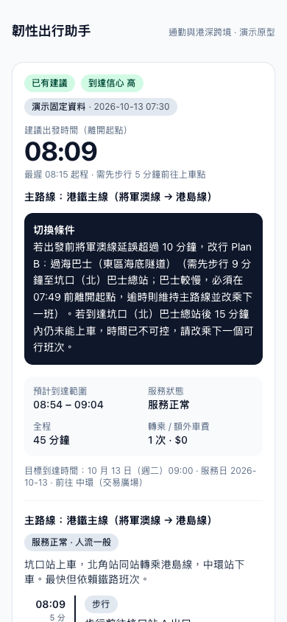
A tested prototype, with evidence limits
595
tests passed · integrated app
43 test files
1,129
passes across three saved versions
Includes shared regressions
Lint, type checks and production builds passed. No completed human usability study is claimed.
Browser QA · 390px
Source: fresh vitest run, 18 Oct 2026; release-checks/RELEASE_REVIEW.md for earlier review.
09
Notes:
Fresh tests on 18 October 2026: integrated application 595 passes in 43 files; two saved app versions 267 passes each, for 1,129 total including overlapping regressions. These are engineering checks, not completed user trials.

Slide 10
Impact will be measured in a small pilot
SDG 11.2
SDG 13.1
Support informed use of public transport within a traveller’s time and cost constraints.
Help users recognise disruption and defer travel when the scenario cannot support a recommendation.
Proposed pilot
Measures and guardrails
10–15 consenting commuters over 5–10 travel days. Compare with their existing planning tools.
Planning time, lateness, extra cost and understanding of uncertainty. No measured carbon or congestion impact yet.
SDG alignment: UN targets 11.2 and 13.1. Pilot targets are proposed, not achieved outcomes.
10
Notes:
25 seconds. We align with public transport access and climate resilience. We propose a pilot with 10 to 15 commuters over 5 to 10 travel days, comparing the prototype with their existing tools. We will track planning time, late arrivals, extra cost and understanding of uncertainty. No emissions reduction or congestion benefit has yet been measured. https://sdgs.un.org/goals/goal11
https://sdgs.un.org/goals/goal13

Slide 11
A focused path to adoption
Initial access
Funding hypothesis
A mobile web app for one university or employer commute community. A partner is not yet confirmed.
Free core traveller access, with an institutional pilot or support contract if value is demonstrated.
Operating costs
Expansion gate
Node hosting, address and route providers, feed updates, monitoring and a managed foot router.
Expand corridors only after coverage, usability and provider costs meet agreed pilot thresholds.
Business model and costs are hypotheses for validation. No customers or institutional partners are confirmed.
11
Notes:
Model calls are optional and their latency and cost need evaluation alongside user comprehension before a wider pilot.

Slide 12
Uncertainty remains visible to the user
Travel advice
Privacy
Show sources and uncertainty. No calibrated on-time probability, live queue guarantee or emergency navigation claim.
Server-side API keys. Search and routing can send locations to external providers. A pilot needs consent and retention controls.
Inclusion
Maintenance
Mobile layout checks passed. Screen-reader, step-free routing and real-device testing still need validation.
Production dependency audit: zero known findings at review. Seven high development-tool findings remain disclosed.
Source: implementation and release review. Controls reduce risk but do not certify route safety.
12
Notes:
25 seconds. We label fixtures and estimates, avoid unsupported complete cross-border journeys and keep credentials on the server. We still need accessibility field checks and clear retention policies for search and location data sent to providers. Automated checks cannot guarantee safe travel. Seven high development-dependency audit findings also remain documented.

Slide 13
The next milestone is a measured pilot
Period | Planned milestone | Evidence required
Weeks 1–2 | Deploy and verify a bounded corridor | Provider probes, accessibility review and consent flow
Weeks 3–4 | Run user tasks and explanation comparisons | Task completion and factual-error analysis
Weeks 5–6 | Run the commute pilot | Planning time, lateness and extra-cost comparison
We seek a pilot host, consenting commuters and transport-data review.
Proposed plan after the competition. Milestones depend on user recruitment and provider access.
13
Notes:
20 seconds. Our next step is a bounded pilot, not a citywide launch. First verify data and deploy the prototype. Then test explanations and decision comprehension, before measuring travel outcomes. We seek a university or employer partner, transport expertise and feedback from commuters.

Slide 14
Appendix A reproducible prototype
https://github.com/jijie114514-oss/eight-university-hackathon
Live demo: https://eight-university-hackathon.vercel.app
Local: Node.js 24 · node deploy-local.mjs integrated
Second stage: / · First stage: /phase1
Select “Central to Futian” for the fixed demo.
Switch normal service, East Rail disruption and black rainstorm.
Open /phase1 for the first-stage commute.
Release checks and known limitations
The public repository, live demo and embedded screenshots provide prototype proof.
14
Notes:
The GitHub repository is embedded as a visible, clickable link. The live website is online, but provider-backed functions still depend on privately configured keys. The fixed demo does not need a key.

Slide 15
Appendix Recorded provider coverage
Recorded probe | Result | Interpretation
HK district-coordinate samples | 12 / 12 | Reference route to Shenzhen Bay HK bus terminal
Initial complete cross-border samples | 3 / 3 | Central, Tsim Sha Tsui and Mong Kok to Futian
Shenzhen named POI samples | 8 / 8 each direction | One POI per district with Central as HK endpoint
The public GitHub repository contains no provider key. Saved probes are not field trials or an all-city coverage guarantee.
Archived probes dated 17 October 2026. Reviewed from supplied artifacts, not re-run with a live key in this release.
15
Notes:
The public repository excludes private provider keys. Archived provider probes are selected samples and not field trials or all-city coverage evidence.

Slide 16
Appendix WorkBuddy evidence
Documented contribution
Human integration decision
A decision-interface draft with rules for provenance, missing information and constrained explanation.
Replace the placeholder corridor, reconcile field naming and add supported fields to the main contract.
Reusable asset
Attribution boundary
A schema-and-validation workflow that another team can apply to a source-backed decision tool.
No WorkBuddy token counts, speed gains or underlying model identity are claimed. Other tools’ work is excluded.
Source: archived WorkBuddy contract and integration reconciliation. Separate optional report prepared.
16
Notes:
The archive attributes the 6 October contract draft to WorkBuddy and member C. The project retained the useful schema and provenance principles, while changing the placeholder corridor and mapping fields into the main app. This is documentary evidence of a bounded contribution, not proof that WorkBuddy generated the entire application. https://github.com/jijie114514-oss/eight-university-hackathon/blob/a140f0817a5e91bd9319fd0632f940934e975e31/A%E9%83%A8%E5%88%86/app/docs/contracts/C_%E6%8E%A5%E5%8F%A3%E5%A5%91%E7%BA%A6_v1_workbuddy.md
https://github.com/jijie114514-oss/eight-university-hackathon/blob/a140f0817a5e91bd9319fd0632f940934e975e31/A%E9%83%A8%E5%88%86/app/docs/DECISION_CONTRACT_CHANGE_REQUEST.md

Slide 17
Appendix Sources and evidence
Competition submission requirements
Judging criteria
Hong Kong public transport patronage
September 2023 rainfall and disruption
UN SDG 11 transport access
UN SDG 13 climate resilience
Release verification and limitations
Transit coverage and probe definitions
Explanation interface and safeguards
Archived WorkBuddy contract
Human integration change record
Links are embedded. Full URLs and source context also appear in speaker notes.
17
Notes:
rules: https://www.hack4sdg.com/2026-roadmap/final-submission-2026/
judge: https://www.hack4sdg.com/judging-criteria/
td: https://www.td.gov.hk/mini_site/atd/2025/en/section5-1.html
hko: https://www.hko.gov.hk/en/wxinfo/pastwx/mws2023/mws202309.htm
sdg11: https://sdgs.un.org/goals/goal11
sdg13: https://sdgs.un.org/goals/goal13
review: https://github.com/jijie114514-oss/eight-university-hackathon/blob/a140f0817a5e91bd9319fd0632f940934e975e31/release-checks/RELEASE_REVIEW.md
coverage: https://github.com/jijie114514-oss/eight-university-hackathon/blob/a140f0817a5e91bd9319fd0632f940934e975e31/A%E9%83%A8%E5%88%86/app/docs/transit/TRANSIT_COVERAGE.md
wb: https://github.com/jijie114514-oss/eight-university-hackathon/blob/a140f0817a5e91bd9319fd0632f940934e975e31/A%E9%83%A8%E5%88%86/app/docs/contracts/C_%E6%8E%A5%E5%8F%A3%E5%A5%91%E7%BA%A6_v1_workbuddy.md
contract: https://github.com/jijie114514-oss/eight-university-hackathon/blob/a140f0817a5e91bd9319fd0632f940934e975e31/A%E9%83%A8%E5%88%86/app/docs/DECISION_CONTRACT_CHANGE_REQUEST.md
explain: https://github.com/jijie114514-oss/eight-university-hackathon/blob/a140f0817a5e91bd9319fd0632f940934e975e31/A%E9%83%A8%E5%88%86/app/src/lib/decision/explain.ts

